Slide 1
Macroeconomics ECON 101
Where Prices Come From: The Interaction of Supply and Demand
(Chapter 3)
Instructor: Muhebullah Karimzada
Notes:
If this PowerPoint presentation contains mathematical equations, you may need to check that your computer has the following installed:
1) MathType Plugin
2) Math Player (free versions available)
3) NVDA Reader (free versions available)

Slide 2
Chapter Outline
3.1 The Demand Side of the Market
3.2 The Supply Side of the Market
3.3 Market Equilibrium: Putting Buyers and Sellers Together
3.4 The Effect of Demand and Supply Shifts on Equilibrium

Slide 3
The Demand Side of the Market
3.1 Learning Objective
Discuss the variables that influence demand.
We begin our analysis of where prices come from by investigating how buyers behave.
We refer to this as market demand, the demand by all the consumers of a given good or service.

Slide 4
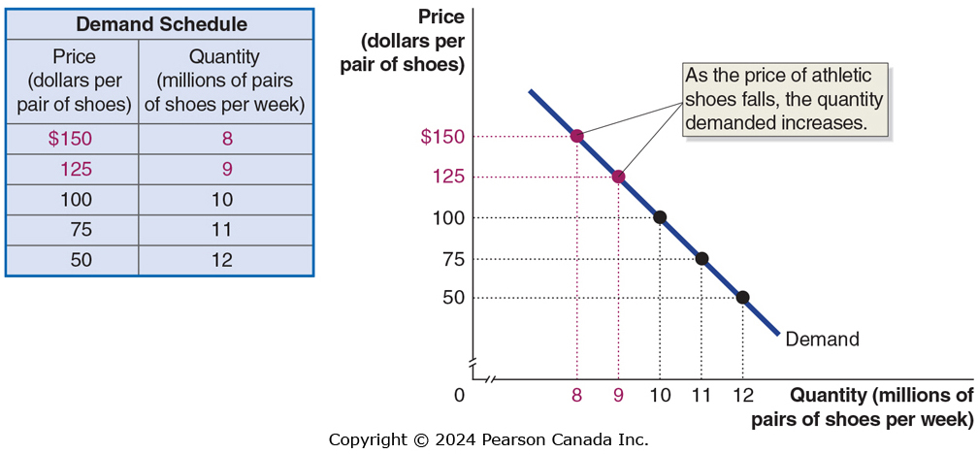
Figure 3.1 A Demand Schedule and Demand Curve (1 of 3)
Demand schedule: A table that shows the relationship between the price of a product and the quantity of the product demanded.
Demand curve: A curve that shows the relationship between the price of a product and the quantity of the product demanded.

Slide 5
Figure 3.1 A Demand Schedule and Demand Curve (2 of 3)
When drawing the demand curve, we assume ceteris paribus.
Ceteris paribus (“all else equal”) condition: The requirement that when analyzing the relationship between two variables—such as price and quantity demanded—other variables must be held constant.

Slide 6
Figure 3.1 A Demand Schedule and Demand Curve (3 of 3)
Quantity demanded: The amount of a good or service that a consumer is willing and able to purchase at a given price.
Law of demand: A rule that states that, holding everything else constant, when the price of a product falls, the quantity demanded of the product will increase, and when the price of a product rises, the quantity demanded of the product will decrease.

Slide 7
What Explains the Law of Demand?
When the price of a good falls, two effects take place:
Consumers substitute toward the good whose price has fallen.
Consumers have more purchasing power, which is like an increase in income.
We call these the substitution effect and the income effect:
Substitution effect: The change in the quantity demanded of a good that results from a change in price, making the good more or less expensive relative to other goods, holding constant the effect of the price change on consumer purchasing power.
Income effect: The change in the quantity demanded of a good that results from the effect of a change in the good’s price on a consumers’ purchasing power, holding all other factors constant.

Slide 8
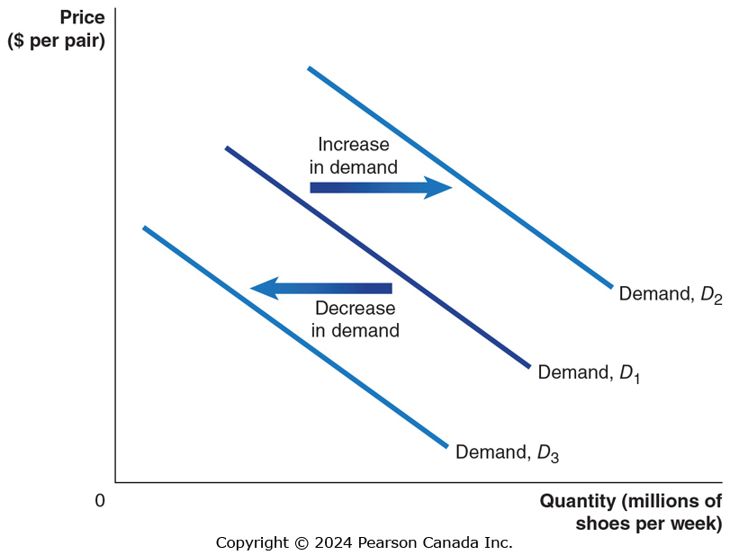
Figure 3.2 Shifting the Demand Curve (1 of 2)
A change in something other than price that affects demand causes the entire demand curve to shift. is a decrease in demand.
A shift to the right (D₁ to D₂) is an increase in demand.
A shift to the left (D₁ to D₃) is a decrease in demand.

Slide 9
Figure 3.2 Shifting the Demand Curve (2 of 2)
As the demand curve shifts, the quantity demanded will change, even if the price doesn’t change.
The quantity demanded changes at every possible price.

Slide 10
Variables That Shift Market Demand
Income of consumers
Increase in income increases demand if the product is normal, decreases demand if the product is inferior.
Prices of related goods
Increase in price of related good increases demand if products are substitutes, decreases demand if products are complements
Tastes
Population and demographics
Expectations
We will discuss how each of these affects demand.

Slide 11
Changes in Income of Consumers
Normal goods: Goods for which the demand increases as income rises and decreases as income falls.
Examples:
New clothes
Restaurant meals
Vacations
Inferior goods: Goods for which the demand increases as income falls and decreases as income rises.
Examples:
Second-hand clothes
Instant noodles

Slide 12
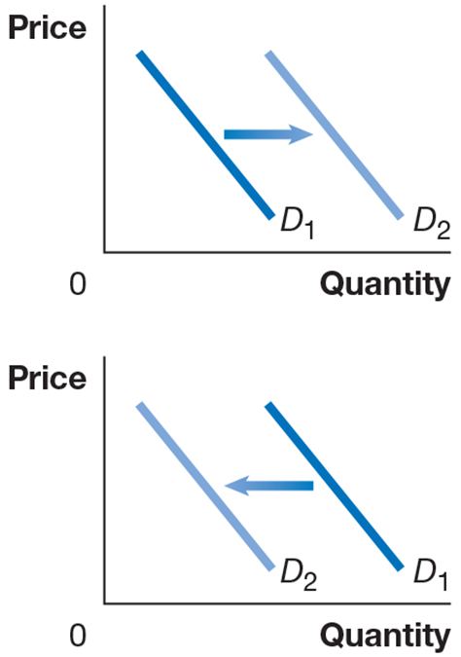
Effects of Changes in Income
An increase in income would increase the demand for new clothes, ceteris paribus.
However, the same increase in income would likely decrease the demand for second-hand clothes.
Notes:
Long Description:
The line graph with the x-axis labeled quantity and the y-axis labeled price. Two lines labeled D1 and D2 lie parallel to each other forming downward slopes. The line D2 lie outwards the line D1. Two arrows flow from the line D1 to D2.
Long Description:
The line graph with the x-axis labeled quantity and the y-axis labeled price. Two lines labeled D1 and D2 lie parallel to each other forming downward slopes. The line D2 lie outwards the line D1. Two arrows flow from the line D2 to D1.

Slide 13

Apply the Concept: The Transformation of Lobster from Inferior to Normal Good
Describing a good as normal or inferior only tells us about how consumers behave.
Do people buy more or less when their incomes rise?
In some parts of the Maritimes, lobster is an inferior good – people eat less of it when their incomes rise.
In Toronto or Calgary, lobster is a normal good – people eat more when their incomes rise.
Goods can be normal in one place and inferior in another.
Despite its high cost in many restaurants, lobster can still be an inferior good.
Notes:
Whether a good is inferior or normal can also change over time as tastes and preferences change and as new products enter the market.

Slide 14
Change in the Price of Related Goods
Substitutes: Goods and services that can be used for the same purpose.
Examples:
Big Mac and Whopper
Ford F-150 and Dodge Ram
Jeans and Khakis
Complements: Goods and services that are used together.
Examples:
Big Mac and McDonald’s fries
Hot dogs and hot dog buns
Left shoes and right shoes

Slide 15
Effects of Changes in the Price of Related Goods
An increase in the price of a Big Mac would increase the demand for Whoppers.
However, the same increase in the price of a Big Mac would decrease the demand for McDonald’s fries.
Notes:
Long Description:
The line graph with the x-axis labeled quantity and the y-axis labeled price. Two lines labeled D1 and D2 lie parallel to each other forming downward slopes. The line D2 lie outwards the line D1. Two arrows flow from the line D1 to D2.
Long Description:
The line graph with the x-axis labeled quantity and the y-axis labeled price. Two lines labeled D1 and D2 lie parallel to each other forming downward slopes. The line D2 lie outwards the line D1. Two arrows flow from the line D2 to D1.

Slide 16
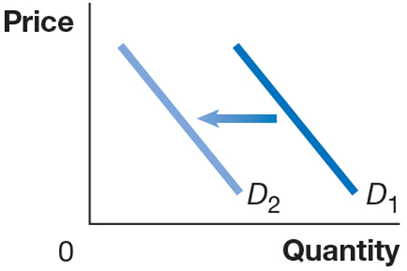
Changes in Tastes
Tastes
If consumers’ tastes change, they may buy more or less of the product.
Example: If consumers become more concerned about eating healthy, they might decrease their demand for fast food.

Slide 17
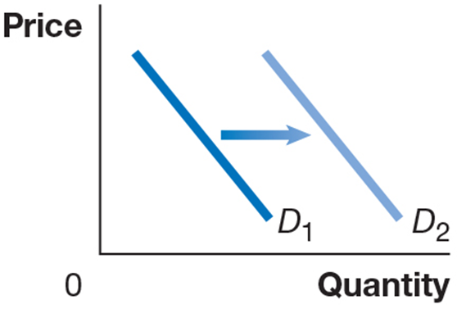
Changes in Population and Demographics
Demographics: The characteristics of a population with respect to age, race, and gender.
Increases in the number of people buying something will increase the amount demanded.
Example: An increase in the elderly population increases the demand for medical care.

Slide 18
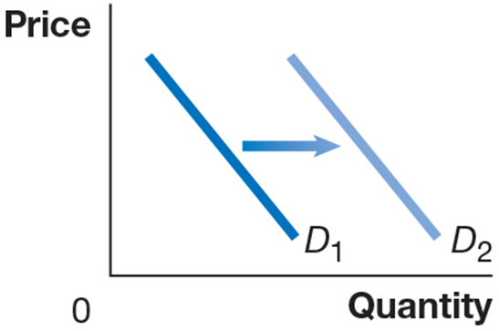
Changes in Expectations About Future Prices
Consumers decide which products to buy and also when to buy them.
Future products are substitutes for current products.
An expected increase in the price tomorrow increases demand today.
An expected decrease in the price tomorrow decreases demand today.
Example: If you found out the price of gasoline would go up tomorrow, you would increase your demand today.
Notes:
Long Description:
The line graph with the x-axis labeled quantity and the y-axis labeled price. Two lines labeled D1 and D2 lie parallel to each other forming downward slopes. The line D2 lie outwards the line D1. Two arrows flow from the line D1 to D2.

Slide 19
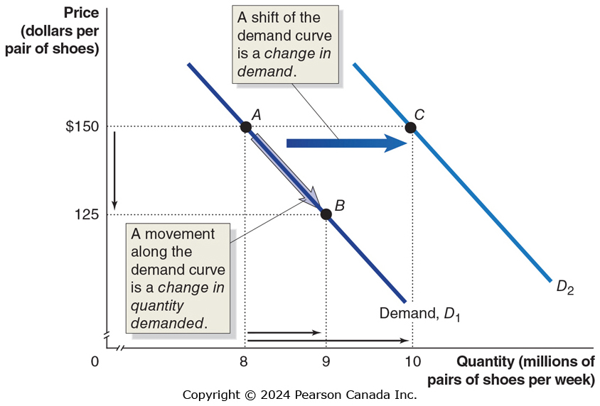
Figure 3.3 A Change in Demand vs a Change in Quantity
A change in the price of the product being examined causes a movement along the demand curve.
This is a change in quantity demanded.
Any other change affecting demand causes the entire demand curve to shift.
This is a change in demand.

Slide 20
The Supply Side of the Market
3.2 Learning Objective
Discuss the variables that influence supply.
There are some similarities, and some important differences, between the demand and supply sides of the market.
In this section, we examine the market supply, i.e., the decisions of (generally) firms about how much of a product to provide at various prices.

Slide 21
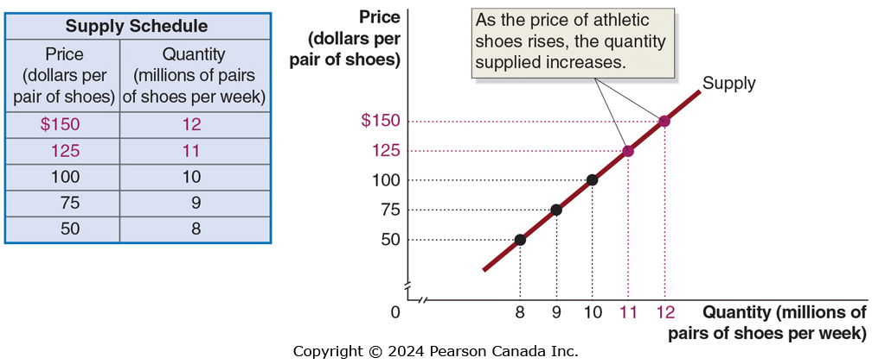
Figure 3.4 A Supply Schedule and Supply Curve (1 of 2)
Supply schedule: A table that shows the relationship between the price of a product and the quantity of the product supplied.
Supply curve: A curve that shows the relationship between the price of a product and the quantity of the product supplied.

Slide 22
Figure 3.4 A Supply Schedule and Supply Curve (2 of 2)
Quantity supplied: The amount of a good or service that a firm is willing and able to supply at a given price.
Law of supply: A rule that states that, holding everything else constant, increases in price cause increases in the quantity supplied, and decreases in price cause decreases in the quantity supplied.

Slide 23
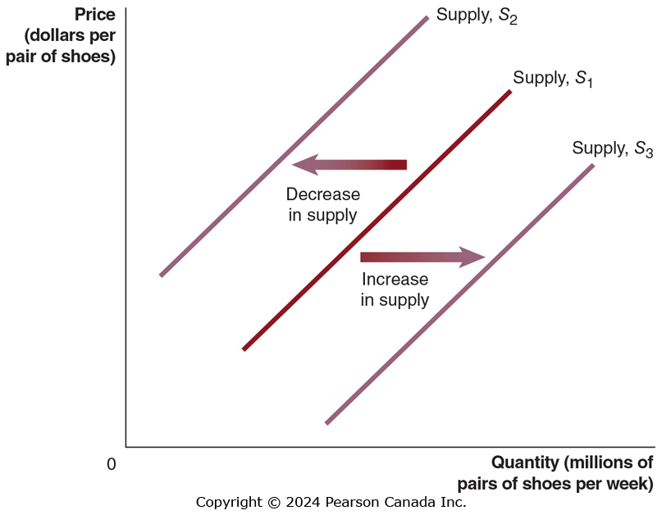
Figure 3.5 Shifting the Supply Curve (1 of 2)
A change in something other than price that affects supply causes the entire supply curve to shift.
A shift to the right (S₁ to S₃) is an increase in supply.
A shift to the left (S₁ to S₂) is a decrease in supply.

Slide 24
Figure 3.5 Shifting the Supply Curve (2 of 2)
As the supply curve shifts, the quantity supplied will change, even if the price doesn’t change.
The quantity supplied changes at every possible price.

Slide 25
What Variables Shift Market Supply?
Prices of inputs
Technological change
Prices of substitutes in production
Number of firms in the market
Expected future prices
We will discuss how each of these affect supply.

Slide 26
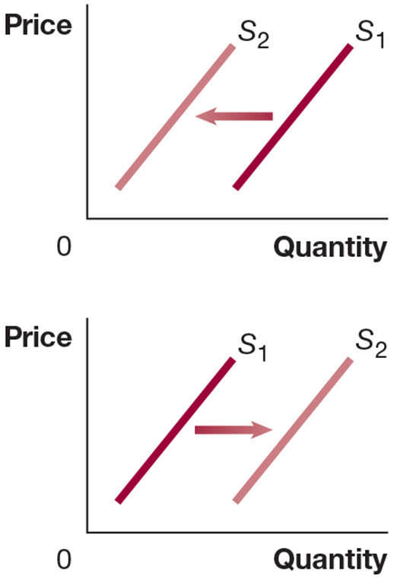
Change in Prices of Inputs
Inputs are anything used in the production of a good or service.
For an athletic shoe, inputs include the rubber, plastic, and labor.
An increase in the price of an input decreases the profitability of selling the good, causing a decrease in supply.
A decrease in the price of an input increases the profitability of selling the good, causing an increase in supply.
Notes:
Long Description:
The line graph shows the x-axis labeled quantity and y-axis labeled price. Two lines labeled S1 and S2 form upward slopes. The line S2 lies towards the left of S1. An arrow flows from the line S1 to the line S2.
Long Description:
The line graph shows the x-axis labeled quantity and y-axis labeled price. Two lines labeled S1 and S2 form upward slopes. The line S2 lies towards the right of S1. An arrow flows from the line S1 to the line S2.

Slide 27
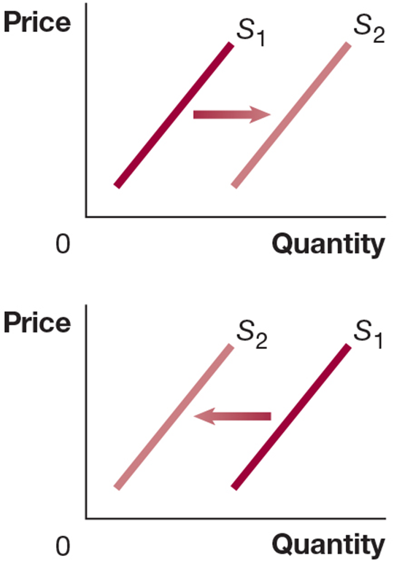
Technological Change
A firm may experience a positive or negative change in its ability to produce a given level of output with a given quantity of inputs. We call this a technological change.
Examples:
A new, more efficient way of producing shoes would increase their supply.
Governmental restrictions on how much workers are allowed to work might decrease the supply of athletic shoes.
Notes:
Long Description:
The line graph shows the x-axis labeled quantity and y-axis labeled price. Two lines labeled S1 and S2 form upward slopes. The line S2 lies towards the right of S1. An arrow flows from the line S1 to the line S2.

Slide 28
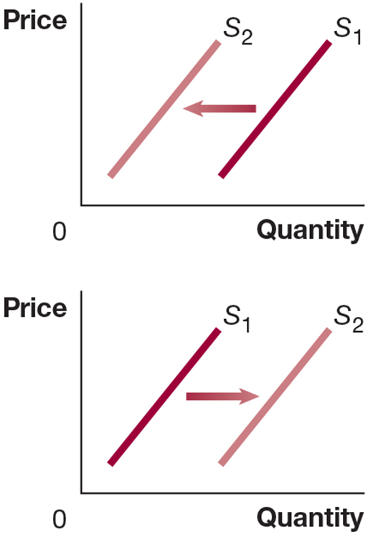
Prices of Substitutes in Production
Many firms can produce and sell alternative products: substitutes in production.
Example: An Ontario farmer can plant either corn or soybeans. If the price of soybeans rises, that farmer will plant (supply) less corn.
Sometimes, two products are necessarily produced together: complements in production
Example: Cattle provide both beef and leather. An increase in the price of beef encourages more cattle farming, which increases the supply of leather.
Notes:
Long Description:
The line graph shows the x-axis labeled quantity and y-axis labeled price. Two lines labeled S1 and S2 form upward slopes. The line S2 lies towards the left of S1. An arrow flows from the line S1 to the line S2.
Long Description:
The line graph shows the x-axis labeled quantity and y-axis labeled price. Two lines labeled S1 and S2 form upward slopes. The line S2 lies towards the right of the line S1. An arrow flows from the line S1 to the line S2.

Slide 29
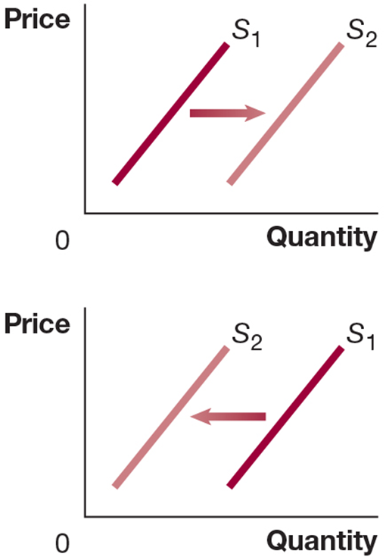
Number of Firms in the Market and Expected Future Prices
More firms in the market will result in more product available at a given price (greater supply).
If a firm anticipates that the price of its product will be higher in the future, it might decrease its supply today in order to increase it in the future.
Notes:
Long Description:
The line graph shows the x-axis labeled quantity and y-axis labeled price. Two lines labeled S1 and S2 form upward slopes. The line S2 lies towards the left of S1. An arrow flows from the line S1 to the line S2.

Slide 30
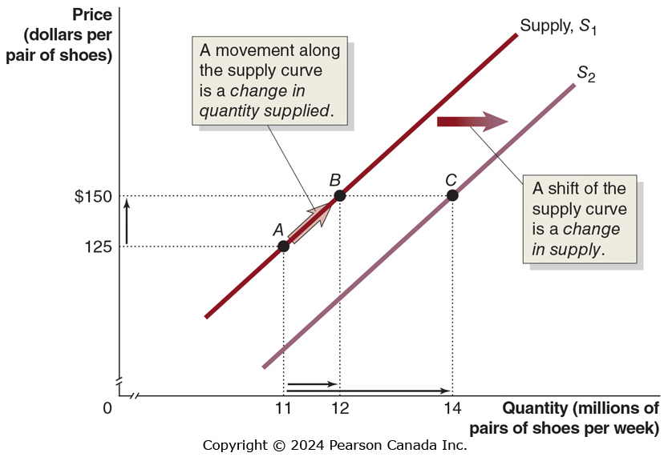
Figure 3.6 A Change in Supply Versus a Change in Quantity Supplied
A change in the price of the product being examined causes a movement along the supply curve.
This is a change in quantity supplied.
Any other change affecting supply causes the entire supply curve to shift.
This is a change in supply.

Slide 31
Market Equilibrium: Putting Buyers and Seller Together
3.3 Learning Objective
Use a graph to illustrate market equilibrium.
Market equilibrium is a situation in which quantity demanded equals quantity supplied.
Recall that markets with many buyers and sellers are perfectly competitive markets; a market equilibrium in one of these markets is called a competitive market equilibrium.
There are ~35 firms selling athletic shoes; we will assume this is enough to generate competitive behaviour in the market for athletic shoes.

Slide 32
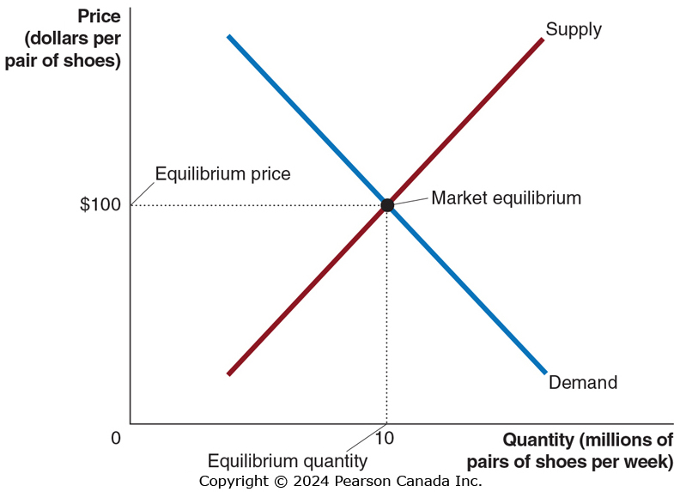
Figure 3.7 Market Equilibrium
At a price of $100,
consumers want to buy 10 million pairs of shoes per week, and
producers want to sell 10 million pairs of shoes per week.
We say the equilibrium price in this market is $100, and the equilibrium quantity is 10 million pairs of shoes per week.
Since buyers and sellers want to trade the same quantity at the price of $100, we do not expect the price to change.

Slide 33
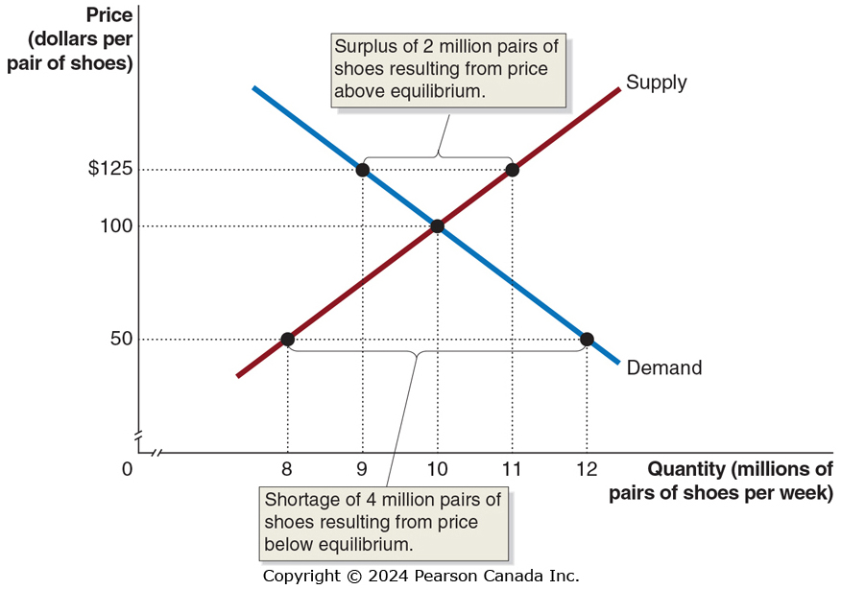
Figure 3.8 The Effect of Surpluses and Shortages on the Market Price (1 of 2)
What if the price were $125 instead?
At a price of $125,
consumers want to buy 9 million pairs of shoes, while
producers want to sell 11 million pairs.
This gives a surplus of 2 million pairs; a situation in which quantity supplied is greater than quantity demanded.
Prediction: Sellers will compete among themselves, driving the price down.

Slide 34
Figure 3.8 The Effect of Surpluses and Shortages on the Market Price (2 of 2)
Now what if the price were $50?
At a price of $50,
consumers want to buy 12 million pairs of shoes, while
producers want to sell 8 million.
This gives a shortage of 4 million pairs of shoes; a situation in which quantity demanded is greater than quantity supplied.
Prediction: Sellers will realize they can increase the price and still sell as many pairs of shoes, so the price will rise.

Slide 35
Demand and Supply Both Count
Price is determined by the interaction of buyers and sellers.
Neither group can dictate price in a competitive market (i.e. one with many buyers and sellers).
However, changes in supply and/or demand will affect the price and quantity traded.

Slide 36
The Effect of Demand and Supply Shifts on Equilibrium
3.4 Learning Objective
Use demand and supply graphs to predict changes in prices and quantities.
Predictions about price and quantity in our model require us to know demand and supply curves.
Typically, we know price and quantity but do not know the curves that generate them.
The power of the demand and supply model is in its ability to predict directional changes in price and quantity traded.

Slide 37
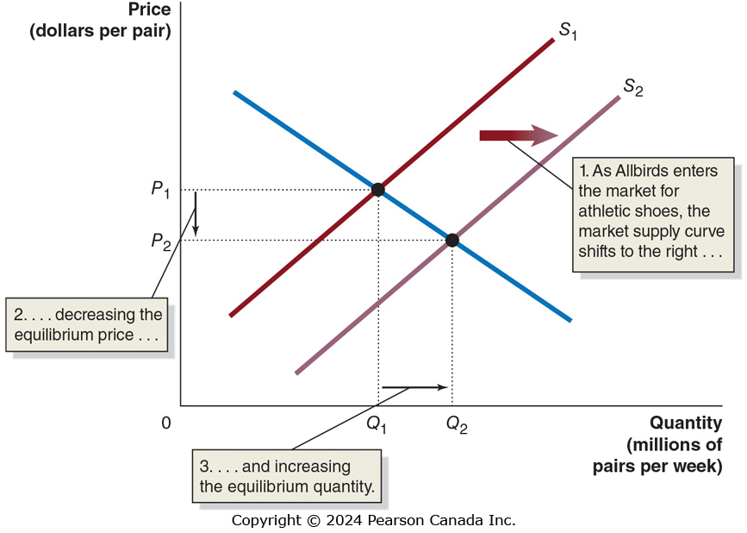
Figure 3.9 The Effect of an Increase in Supply on Equilibrium (1 of 2)
The graph shows the market for athletic shoes as a new shoemaker, Allbirds, enters the market.
When Allbirds enters, more shoes are supplied at any given price—an increase in supply from
Equilibrium price falls from
Equilibrium quantity rises

Slide 38
Figure 3.9 The Effect of an Increase in Supply on Equilibrium (2 of 2)
By how much will price fall? By how much will quantity rise?
We cannot say, without knowing more information.
For now, we can only predict that price will fall and quantity will rise.

Slide 39
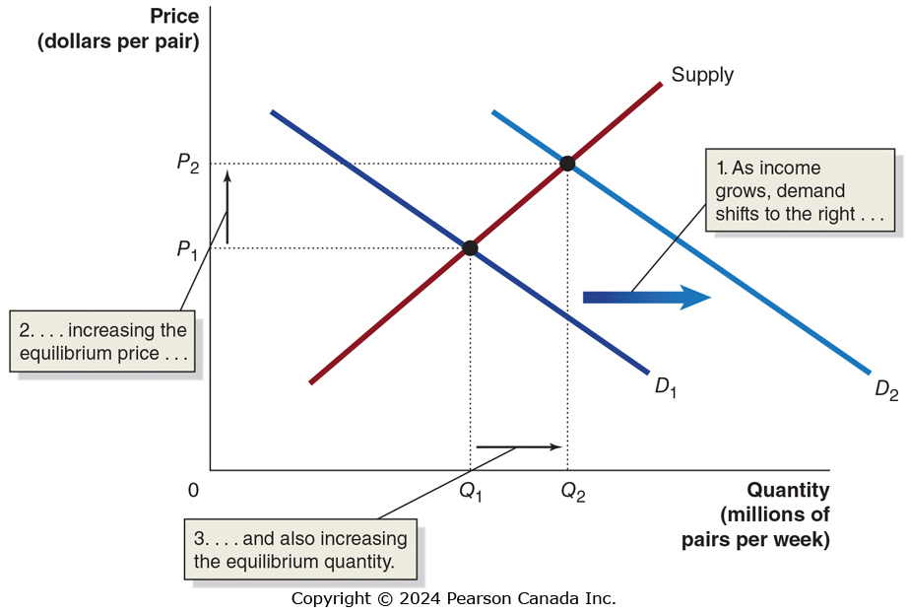
Figure 3.10 The Effect of an Increase in Demand on Equilibrium
Suppose incomes increase. What happens to the equilibrium in the athletic shoe market?
Athletic shoes are a normal good, so as income rises, demand shifts to the right
Equilibrium price rises
Equilibrium quantity rises

Slide 40
Table 3.3 How Shifts in Demand and Supply Affect Equilibrium Price (P) and Quantity (Q) (1 of 2)
Blank | Supply Curve Unchanged | Supply Curve Shifts to the Right | Supply Curve Shifts to the Left
Demand Curve Unchanged | Q unchanged P unchanged | Q increases P decreases | Q decreases P increases
Demand Curve Shifts to the Right | Q increases P increases | Q increases P increases or decreases | Q increases or decreases P increases
Demand Curve Shifts to the Left | Q decreases P decreases | Q increases or decreases P decreases | Q decreases P increases or decreases

Slide 41
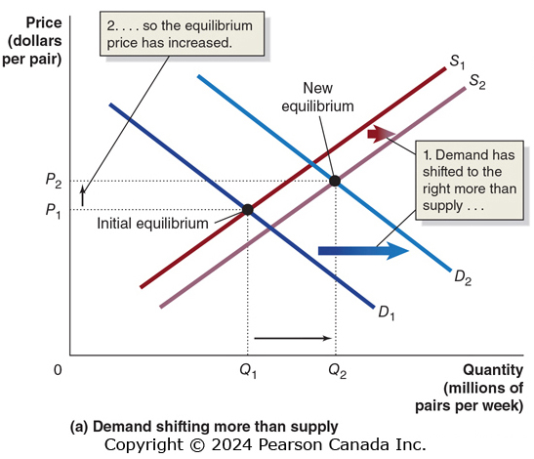
Figure 3.11 Shifts in Demand and Supply Over Time (1 of 3)
Over time, it is likely that both demand and supply will change.
For example, as new firms enter the market for athletic shoes and incomes increase, we expect:
The supply curve will shift to the right, and
The demand curve will shift to the right.

Slide 42
Figure 3.11 Shifts in Demand and Supply Over Time (2 of 3)
What does our model predict?
So we can be sure equilibrium quantity will rise, but the effect on equilibrium price is not clear.
This panel shows demand shifting more than supply: equilibrium price and quantity both rise.

Slide 43
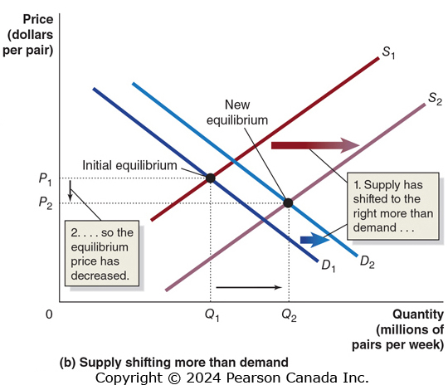
Figure 3.11 Shifts in Demand and Supply Over Time (3 of 3)
This panel shows supply shifting more than demand: quantity rises, but equilibrium price falls.
Without knowing the relative size of the changes, the effect on equilibrium price is ambiguous.
It is possible, but unlikely, that the equilibrium price will remain unchanged.

Slide 44
Table 3.3 How Shifts in Demand and Supply Affect Equilibrium Price (P) and Quantity (Q) (2 of 2)
Blank | Supply Curve Unchanged | Supply Curve Shifts to the Right | Supply Curve Shifts to the Left
Demand Curve Unchanged | Q unchanged P unchanged | Q increases P decreases | Q decreases P increases
Demand Curve Shifts to the Right | Q increases P increases | Q increases P increases or decreases | Q increases or decreases P increases
Demand Curve Shifts to the Left | Q decreases P decreases | Q increases or decreases P decreases | Q decreases P increases or decreases
The cell in red is the example that we just did.

Slide 45
Shifts of a Curve vs. Movements Along a Curve
Suppose an increase in supply occurs. We now know:
Equilibrium quantity will increase, and
Equilibrium price will decrease
It is tempting to believe the decrease in price will cause an increase in demand. But this is incorrect.
The decrease in price will cause a movement along with demand curve, but not an increase in demand.
Why? The demand curve already describes how much of the good consumers want to buy, at any given price.
When the price change occurs, we just look at the demand curve to see what happens to how much consumers want to buy.

